Slide 1
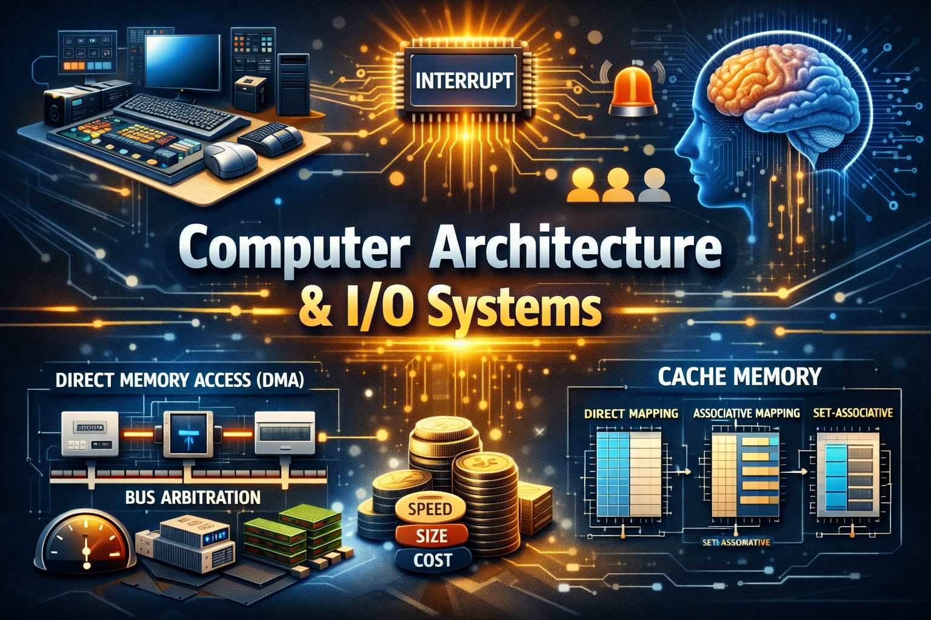

Slide 2
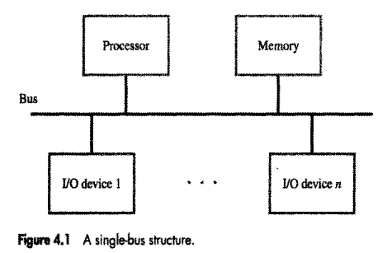
ACCESSING I/O DEVICES
1. The Single-Bus Structure
In a standard computer architecture, the processor, memory, and I/O devices all connect to a single bus. This bus acts as a shared highway for information and consists of three types of lines:
Address Lines: Used to identify a specific device or memory location.
Data Lines:
Control Lines: Used to send commands

Slide 3
2. Memory-Mapped I/O vs. Separate I/O
Feature | Memory-Mapped I/O | Separate I/O (Isolated)
Address Space | I/O devices and memory share the same address map. | I/O devices have their own dedicated 16-bit address space.
Instructions | Any instruction that accesses memory (e.g., Move) works for I/O. | Requires special instructions (e.g., In and Out).
Complexity | Simpler software; treats hardware registers like memory locations. | Requires a special "I/O signal" on the bus to distinguish from memory.
Commonality | Most common approach in modern systems. | Typically found in Intel-family processors.

Slide 4
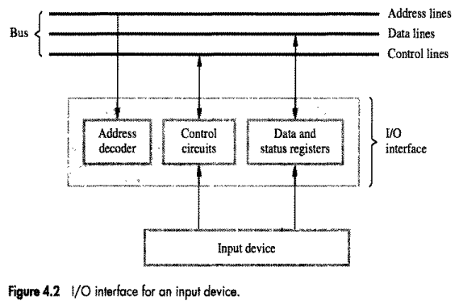

Slide 5
3. The I/O Interface Circuit
Every I/O device requires an interface circuit to bridge the gap between the high-speed bus and the (usually) slower device.
Components of the Interface:
Address Decoder: Monitors the address lines. When it sees the unique address assigned to that device, it "wakes up" the device to respond.
Data Register: A temporary buffer that holds the data being moved in or out.
Status Register: Contains "flags" (bits) that tell the processor the state of the device (e.g., "I have a new character ready" or "I am busy printing").

Slide 6
4. Program-Controlled I/O (Polling)
Because processors are millions of times faster than human input (like typing), the software must synchronize with the hardware. The example provided uses Polling:
The SIN Flag: For a keyboard, the Status Input (SIN) flag is set to 1 when a key is pressed.
The Wait Loop: The processor repeatedly "polls" (checks) the status register in a loop.
The Transfer: Only when SIN = 1 does the processor execute the Move instruction to read the data. Once read, SIN is automatically cleared to 0.

Slide 7
5. Looking Ahead: Other I/O Methods
While polling is simple, it wastes processor time because the CPU sits in a "wait loop." The text mentions two more efficient alternatives:
Interrupts: The device "pings" the processor only when it is ready, allowing the CPU to do other work in the meantime.
Direct Memory Access (DMA): Used for high-speed devices (like hard drives) to send data directly to memory without the CPU acting as a middleman for every byte.

Slide 8
Interrupt Hardware concepts:
The Shared Interrupt Line
In a system with multiple I/O devices, it is inefficient to have a separate physical wire for every single device to request an interrupt. Instead, computers use a common interrupt-request line.
The Problem: If multiple devices are connected to one wire, we need a way to ensure they don't "fight" each other (short circuit) when one tries to send a high voltage while another sends a low voltage.
The Solution: An Open-Drain (or Open-Collector) circuit.

Slide 9
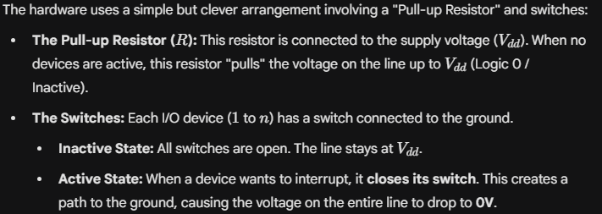
2. How the Open-Drain Circuit Works

Slide 10
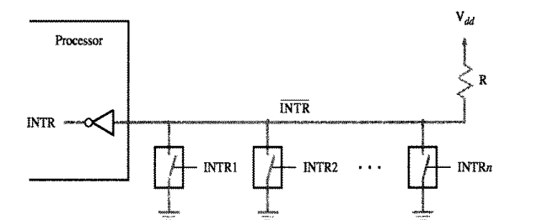

Slide 11
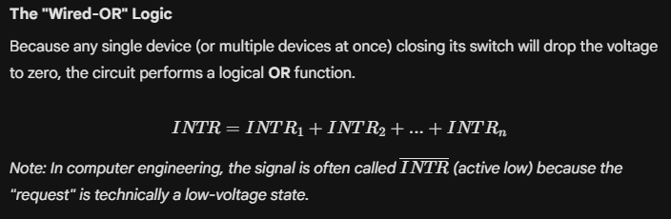
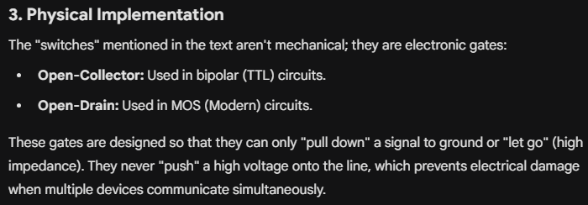

Slide 12
Component | Physical State | Logical Meaning
Pull-up Resistor | Pulls line to V_dd | Default state (No Interrupt)
Device Gate (Open) | High Impedance | Device is idle
Device Gate (Closed) | Path to Ground (0V) | Device is requesting an interrupt
Bus Voltage | Low (0V) | INTR signal is sent to the processor

Slide 13
ENABLING AND DISABLING INTERRUPTS
Why Control Interrupts?
Programmers need to enable or disable interrupts for two main reasons:
Logic Control: An interrupt from a printer is only useful if there is actually data ready to be printed.
Atomicity: Some sequences of instructions must be completed without interference (e.g., updating a shared data table) to prevent data corruption

Slide 14
Preventing Infinite Interrupt Loops
If a device pulls the interrupt line low (active) and the processor jumps to the service routine, the line is still active.
Without a control mechanism, the processor would immediately interrupt itself again, creating an infinite loop.
three hardware/software solutions to this:
Option A: Software Disabling
Option B: Automatic Hardware Disabling
Option C: Edge-Triggered Interrupts

Slide 15
Option A: Software Disabling
The processor is designed to ignore the interrupt line for exactly one instruction cycle after jumping to the service routine.
The first instruction of the routine is Interrupt-disable.
The last instruction (before returning) is Interrupt-enable.

Slide 16
Option B: Automatic Hardware Disabling (Most Common)
The processor automatically handles the "lock-out" as part of the interrupt sequence.
The Processor Status (PS) register contains an Interrupt-enable bit.
When an interrupt occurs, the current PS (with the bit set to 1) is saved on the stack.
The processor automatically clears the Interrupt-enable bit to 0.
When the Return-from-interrupt instruction runs, it pops the old PS off the stack, which restores the bit to 1 and re-enables interrupts.

Slide 17
Option C: Edge-Triggered Interrupts
Instead of looking at the level of the signal (is it low or high?), the processor's hardware only reacts to the leading edge (the moment the signal changes from high to low).
Even if the device keeps the line low for a long time, the processor only "sees" the request once

Slide 18
The Standard Interrupt Sequence
Step | Action | Party Responsible
1 | Raise interrupt request signal | I/O Device
2 | Suspend current program execution | Processor
3 | Disable further interrupts (update PS register) | Processor Hardware
4 | Acknowledge: Tell device "I heard you" (signal deactivates) | Processor/Bus
5 | Execute the Interrupt-Service Routine (ISR) | Software
6 | Re-enable interrupts and resume original program | Processor (via Return instruction)

Slide 19
HANDLING MULTIPLE DEVICES
When multiple devices share a single interrupt line, the processor faces the "ambiguity problem": it knows someone called for help, but it doesn't know who or where their specific service routine is located.

Slide 20
Polling (The Software Solution)
Polling is the simplest method for identifying the source of an interrupt.
Mechanism: When the processor receives an interrupt signal, it jumps to a "generic" interrupt-service routine. This routine sequentially checks the IRQ (Interrupt Request) bit in the status register of every I/O device.
Decision Making: The first device found with an IRQ bit set to 1 is serviced.
Pros: Very simple hardware; requires only one interrupt line.
Cons: Slow. The processor wastes cycles checking devices that didn't even request an interrupt.

Slide 21
Vectored Interrupts (The Hardware Solution)
Vectored interrupts eliminate the need for manual polling by allowing the device to identify itself immediately.
The Interrupt Vector: The device sends a unique code (usually 4 to 8 bits) over the data bus. The processor uses this code to find the Interrupt Vector, which is the starting address of that device’s specific service routine.

Slide 22
The Handshake:
1. The device asserts the INTR line.
2. The processor finishes its current instruction.
3. The processor asserts the INTA (Interrupt Acknowledge) line.
4. The device "sees" the INTA and places its vector code onto the data bus.
5. The processor loads this address into the Program Counter (PC) and starts the service routine

Slide 23
Interrupt Nesting
Interrupt nesting allows a high-priority device to interrupt the service routine of a lower-priority device.
Why? If the processor is busy running a long service routine for a printer and a "Real-Time Clock" sends a request, the clock might lose track of time if it has to wait.
The Mechanism: The processor has a Priority Level stored in its Processor Status (PS) register.
The processor only accepts interrupts from devices with a higher priority than its current level.
When an ISR (Interrupt Service Routine) starts, the processor raises its own priority to match that device, effectively "blocking" all devices of the same or lower priority

Slide 24
Supervisor vs. User Mode
To prevent a regular program from breaking the system, priority changes are restricted:
Supervisor Mode: The processor is in this mode when running Operating System (OS) code. It can execute privileged instructions to change the priority level.
User Mode: The mode for application programs. If a user program tries to change the priority, the hardware triggers a privilege exception (a special error interrupt).

Slide 25
Handling Simultaneous Requests
When multiple devices ask for attention at the exact same moment, the hardware must "break the tie."
three ways to organize this:
A. Individual Lines (Figure 4.7)
The processor has a separate pair of lines (INTR and INTA) for every device. A Priority Arbitration Circuit inside the processor instantly picks the line with the highest hardwired priority.

Slide 26
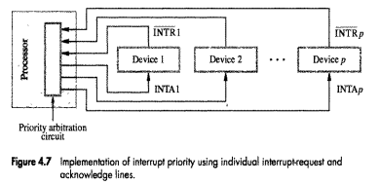

Slide 27
B. The Daisy Chain (Figure 4.8a)
This is a clever way to save on wiring. All devices share one INTR line, but the INTA (Acknowledge) signal is wired in a "serial" chain.
The signal goes to Device 1 first.
If Device 1 requested the interrupt, it "grabs" the signal and doesn't pass it on.
If Device 1 is idle, it passes the signal to Device 2.
Result: Priority is determined by physical distance from the processor

Slide 28
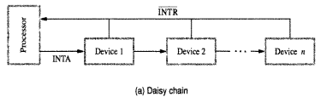

Slide 29
C. Priority Groups (Figure 4.8b)
This is a hybrid approach used in most modern computers.
Devices are organized into Groups based on priority levels (e.g., Level 1, Level 2).
Each group has its own line to the processor (like Method A).
Within each group, several devices are connected via a Daisy Chain (like Method B)

Slide 30
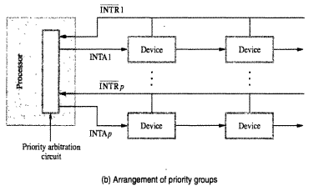

Slide 31
DIRECT MEMORY ACCESS
The Problem with Programmed I/O
In the previous sections, we saw the processor moving data using instructions like Move DATAIN, R0. This creates significant overhead:
CPU Waste: The processor must manually increment memory addresses and decrement word counts for every single byte.
Context Switching: If using interrupts, the CPU must constantly save and restore its state.
Speed Bottleneck: High-speed devices (like disks or network cards) would overwhelm the CPU if it had to handle every individual data word

Slide 32
What is DMA?
DMA allows an I/O device to transfer a block of data directly to or from the main memory without the processor’s constant intervention. This is managed by a specialized hardware circuit called a DMA Controller.
The DMA Controller's Registers
To perform a transfer, the processor "programs" the DMA controller by writing to these registers:
Starting Address: Where in the memory the data should go (or come from).
Word Count: How much data needs to be moved.
Control/Status Register: Contains bits for Direction (Read/Write), Interrupt Enable (IE), and a "Done" flag

Slide 33
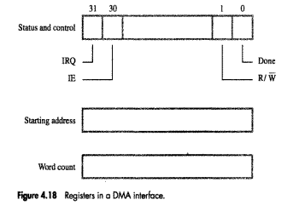

Slide 34
The DMA Transfer Process
Initiation: The processor (via the Operating System) writes the starting address and word count into the DMA controller.
Suspension: The OS puts the requesting program into a Blocked state and starts executing a different program.
Execution: The DMA controller takes control of the bus. It provides the memory addresses and bus signals itself.
Completion: Once the word count reaches zero, the DMA controller sets the Done bit and sends an Interrupt to the processor.
Resumption: The OS handles the interrupt, moves the original program back to the Runnable state, and the program continues, now with its data ready in memory

Slide 35
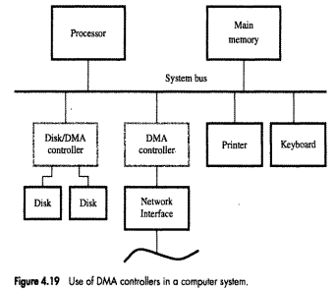

Slide 36
Bus Arbitration & Cycle Stealing
Since both the Processor and the DMA controller need the System Bus to access memory, they must share it. There are two main modes of sharing:
Cycle Stealing: The DMA controller "steals" occasional bus cycles from the processor. This interweaves memory accesses, slowing the processor slightly but keeping it active.
Burst Mode (Block Mode): The DMA controller takes exclusive control of the bus to transfer a full block of data at maximum speed. The processor is completely blocked from the bus during this time.
Note: DMA controllers are always given higher priority than the processor because high-speed devices like disks cannot wait; if they don't move their data immediately, it might be lost as the disk continues to spin.

Slide 37
Modern Implementation: DMA Channels
As shown in Figure 4.19, modern controllers (like a Disk Controller) often provide multiple DMA Channels.
This allows one controller to manage multiple independent hardware devices (like two separate hard drives) simultaneously by duplicating the address and word count registers for each channel.

Slide 38
Bus Arbitration
The process of deciding which hardware device gets to control the system bus at any given time. The device currently in control is called the Bus Master.

Slide 39
Centralized Arbitration
In this approach, a single Bus Arbiter (often part of the CPU) decides who gets control. It uses three main signals to coordinate:
Bus-Request (BR): An open-drain line that any device can pull low to ask for the bus.
Bus-Grant (BG): A signal sent by the arbiter that travels through devices in a Daisy Chain.
Bus-Busy (BBSY): A signal that indicates someone is currently using the bus.

Slide 40
How it works
A DMA controller pulls the BR line.\
The Processor finishes its current task and activates BG1.
The signal hits DMA Controller 1. If Controller 1 doesn't need the bus, it passes the signal to BG2 (Controller 2).
If Controller 2 was the one asking, it "blocks" the signal from going further, waits for BBSY to be released, and then pulls BBSY itself to start its transfer.

Slide 41
Distributed Arbitration
In distributed arbitration, there is no "boss." Instead, all devices work together to decide who wins using a Priority ID.
The Hardware: Each device has a 4-bit ID and is connected to 4 shared arbitration lines (ARB0–ARB3).
The Logic: These lines use open-collector logic, meaning if any device puts a "1" on the line, the line becomes a "1."

Slide 42
The Battle: Devices put their IDs on the lines simultaneously. Each device compares what it sent to what is actually on the bus:
If a device sent a 0 but sees a 1 on the bus, it realizes a higher-priority device is competing.
It immediately shuts off its own drivers for that bit and all lower bits.
Eventually, only the highest ID remains on the bus, and that device becomes the Master

Slide 43
Comparison of Arbitration Styles
Feature | Centralized | Distributed
Control | Single Arbiter (usually CPU) | All devices participate
Wiring | Uses Daisy Chain (BG1, BG2...) | Uses shared ID lines (ARB0-3)
Reliability | If the Arbiter fails, the whole bus fails | Higher reliability (no single point of failure)
Priority | Determined by physical proximity | Determined by software-assigned ID numbers

Slide 44
SPEED, SIZE, AND COST
Memory is either fast, large, or cheap, but never all three at once.
To solve this, designers use a Memory Hierarchy, placing a small amount of expensive, lightning-fast memory near the processor and a massive amount of inexpensive, slower memory further away.

Slide 45
The Three Tiers of Technology
three distinct technologies used to balance performance and price:
SRAM (Static RAM):
Pros: Extremely fast.
Cons: Expensive and bulky (uses 6 transistors per cell).
Use Case: Small, high-speed caches (L1 and L2).
DRAM (Dynamic RAM):
Pros: Simple, dense, and affordable.
Cons: Slower than SRAM.
Use Case: The computer's Main Memory.
Magnetic Disks:
Pros: Massive capacity at a very low cost.
Cons: Mechanically slow compared to semiconductor chips.
Use Case: Secondary storage for files and large datasets.

Slide 46
The Memory Hierarchy
Levels of the Hierarchy:
Processor Registers: The fastest access possible, located directly inside the CPU. Only holds a tiny amount of data (words).
L1 Cache (Primary): Located on the processor chip. It is tiny because it shares physical space with CPU logic.
L2 Cache (Secondary): Larger than L1. It acts as a buffer between the fast L1 and the slower Main Memory.
Main Memory: Implemented with DRAM (via SIMMs/DIMMs). This is where your active programs live. Access is roughly 10x slower than L1 cache.
Secondary Memory (Disk): The bottom tier. It provides massive storage but is the slowest to access.

Slide 47
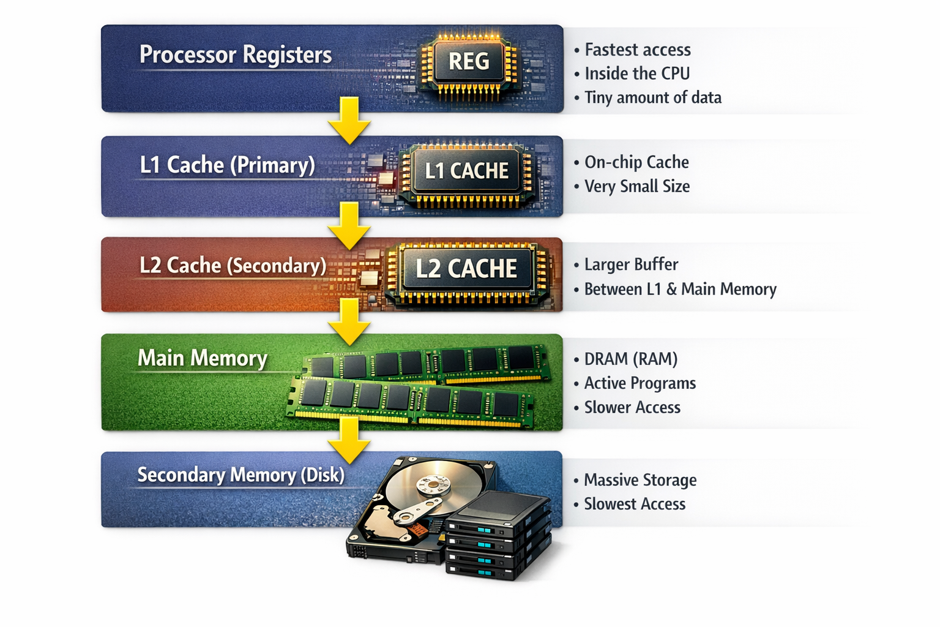

Slide 48
The Goal: Data Proximity
The primary goal of this system is to ensure that instructions and data needed in the "near future" are moved as high up the hierarchy as possible.
This management is largely handled by the hardware (for caches) and the Operating System (for moving data from disk to main memory).

Slide 49
MAPPING FUNCTIONS
used to determine exactly where a block of data from the large Main Memory is stored within the much smaller Cache Memory.
Using the example from the text:
Main Memory: 64K words ($2^{16}$ addresses), viewed as 4096 blocks of 16 words each.
Cache: 2048 words, viewed as 128 blocks of 16 words each.

Slide 50
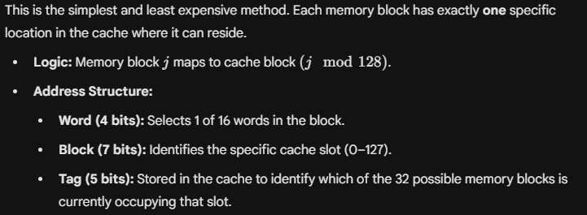
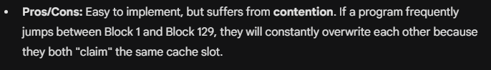
Direct Mapping

Slide 51
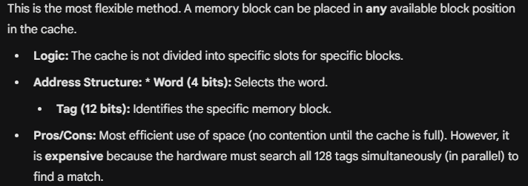
Associative Mapping

Slide 52
Set-Associative Mapping
This is a hybrid approach that balances cost and performance. The cache is divided into sets, and a block can reside in any position within its assigned set.
Example (2-way): 128 blocks are grouped into 64 sets (2 blocks per set).
Logic: Memory block 0, 64, 128... all map to Set 0. The block can be placed in either of the two slots in Set 0.
Address Structure
Word (4 bits): Selects the word.
Set (6 bits): Identifies the set.
Tag (6 bits): Identifies the block within that set.

Slide 53
Control Bits
For the cache to function correctly, two additional bits are often associated with each block:
Valid Bit: Indicates if the data in the block is meaningful (1) or "garbage" from power-on (0).
Dirty (Modified) Bit: Used in "Write-Back" systems to show if the CPU has changed the data in the cache, meaning it must be updated in the main memory before being replaced

Slide 54
The Cache-Coherence Problem
A challenge arises when multiple entities (like the CPU and a DMA controller) access the same memory.
If a DMA updates the Main Memory while the CPU has an old copy in its Cache, the CPU's data becomes "stale."
Solution: The system must clear the "Valid Bit" (invalidate) or "Flush" the cache to ensure both the CPU and I/O devices see the most recent version of the data.

